Slide 1
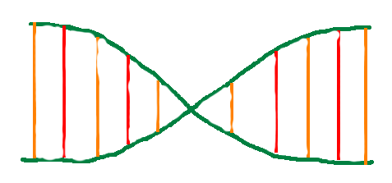
Darwin’s Nightmare
By Jonathan “Jake” Byman (jsb396), Michael Wagner (msw269)

Slide 2
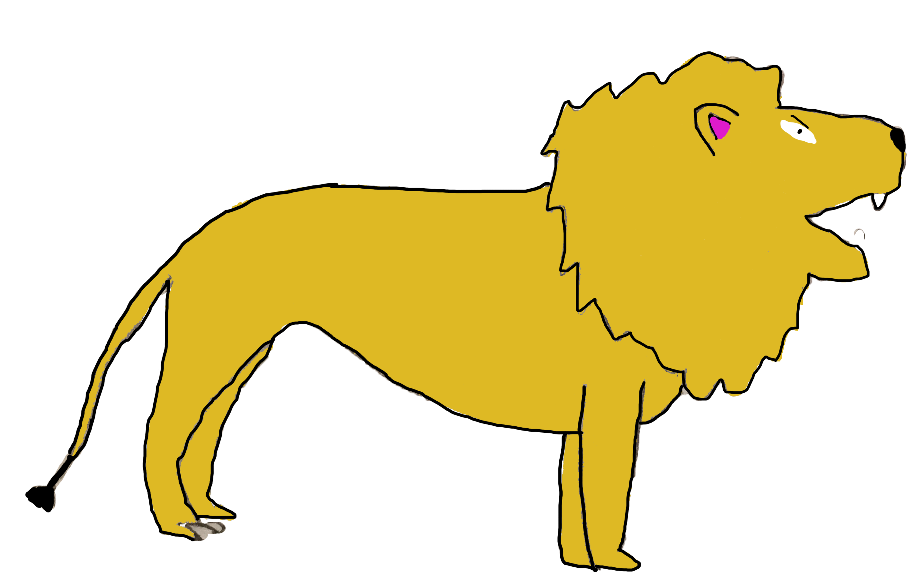
Proposal
To create a game that simulates the natural behavior of evolution
DNA is currency to evolve
Creatures become more smart
Using a QuadTree data structure
Swift: Mac OS

Slide 3
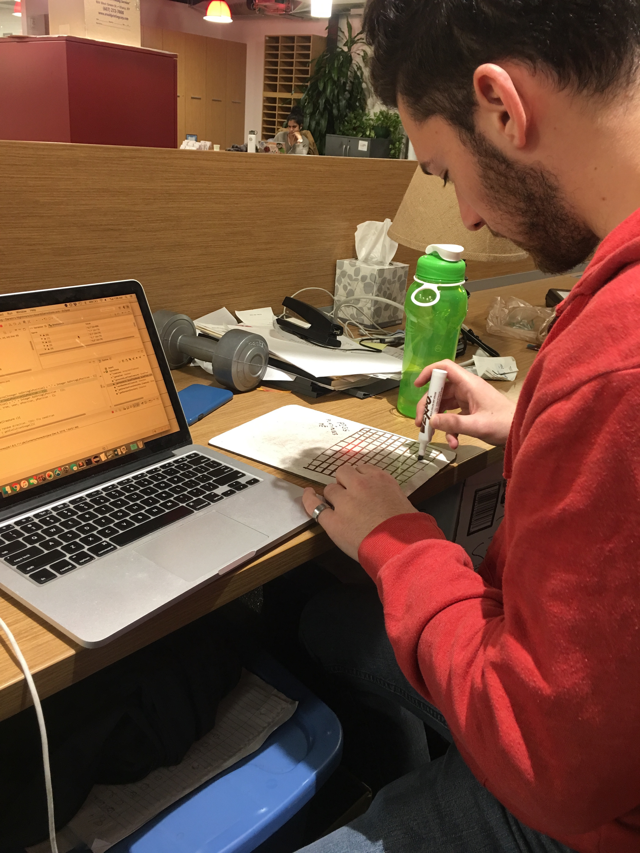
Development
Experience working together
Creating QuadTree too memory intensive
Memory still tricky
Graph was much better
JavaFX a little tricky!

Slide 4
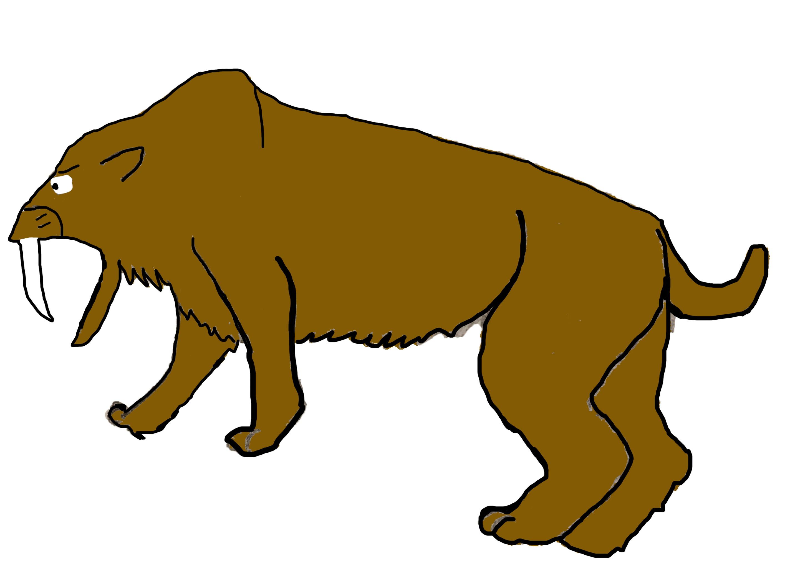
Result
Not quite a game
JavaFX
Emphasis on simulation
Using Graph data structure

Slide 5
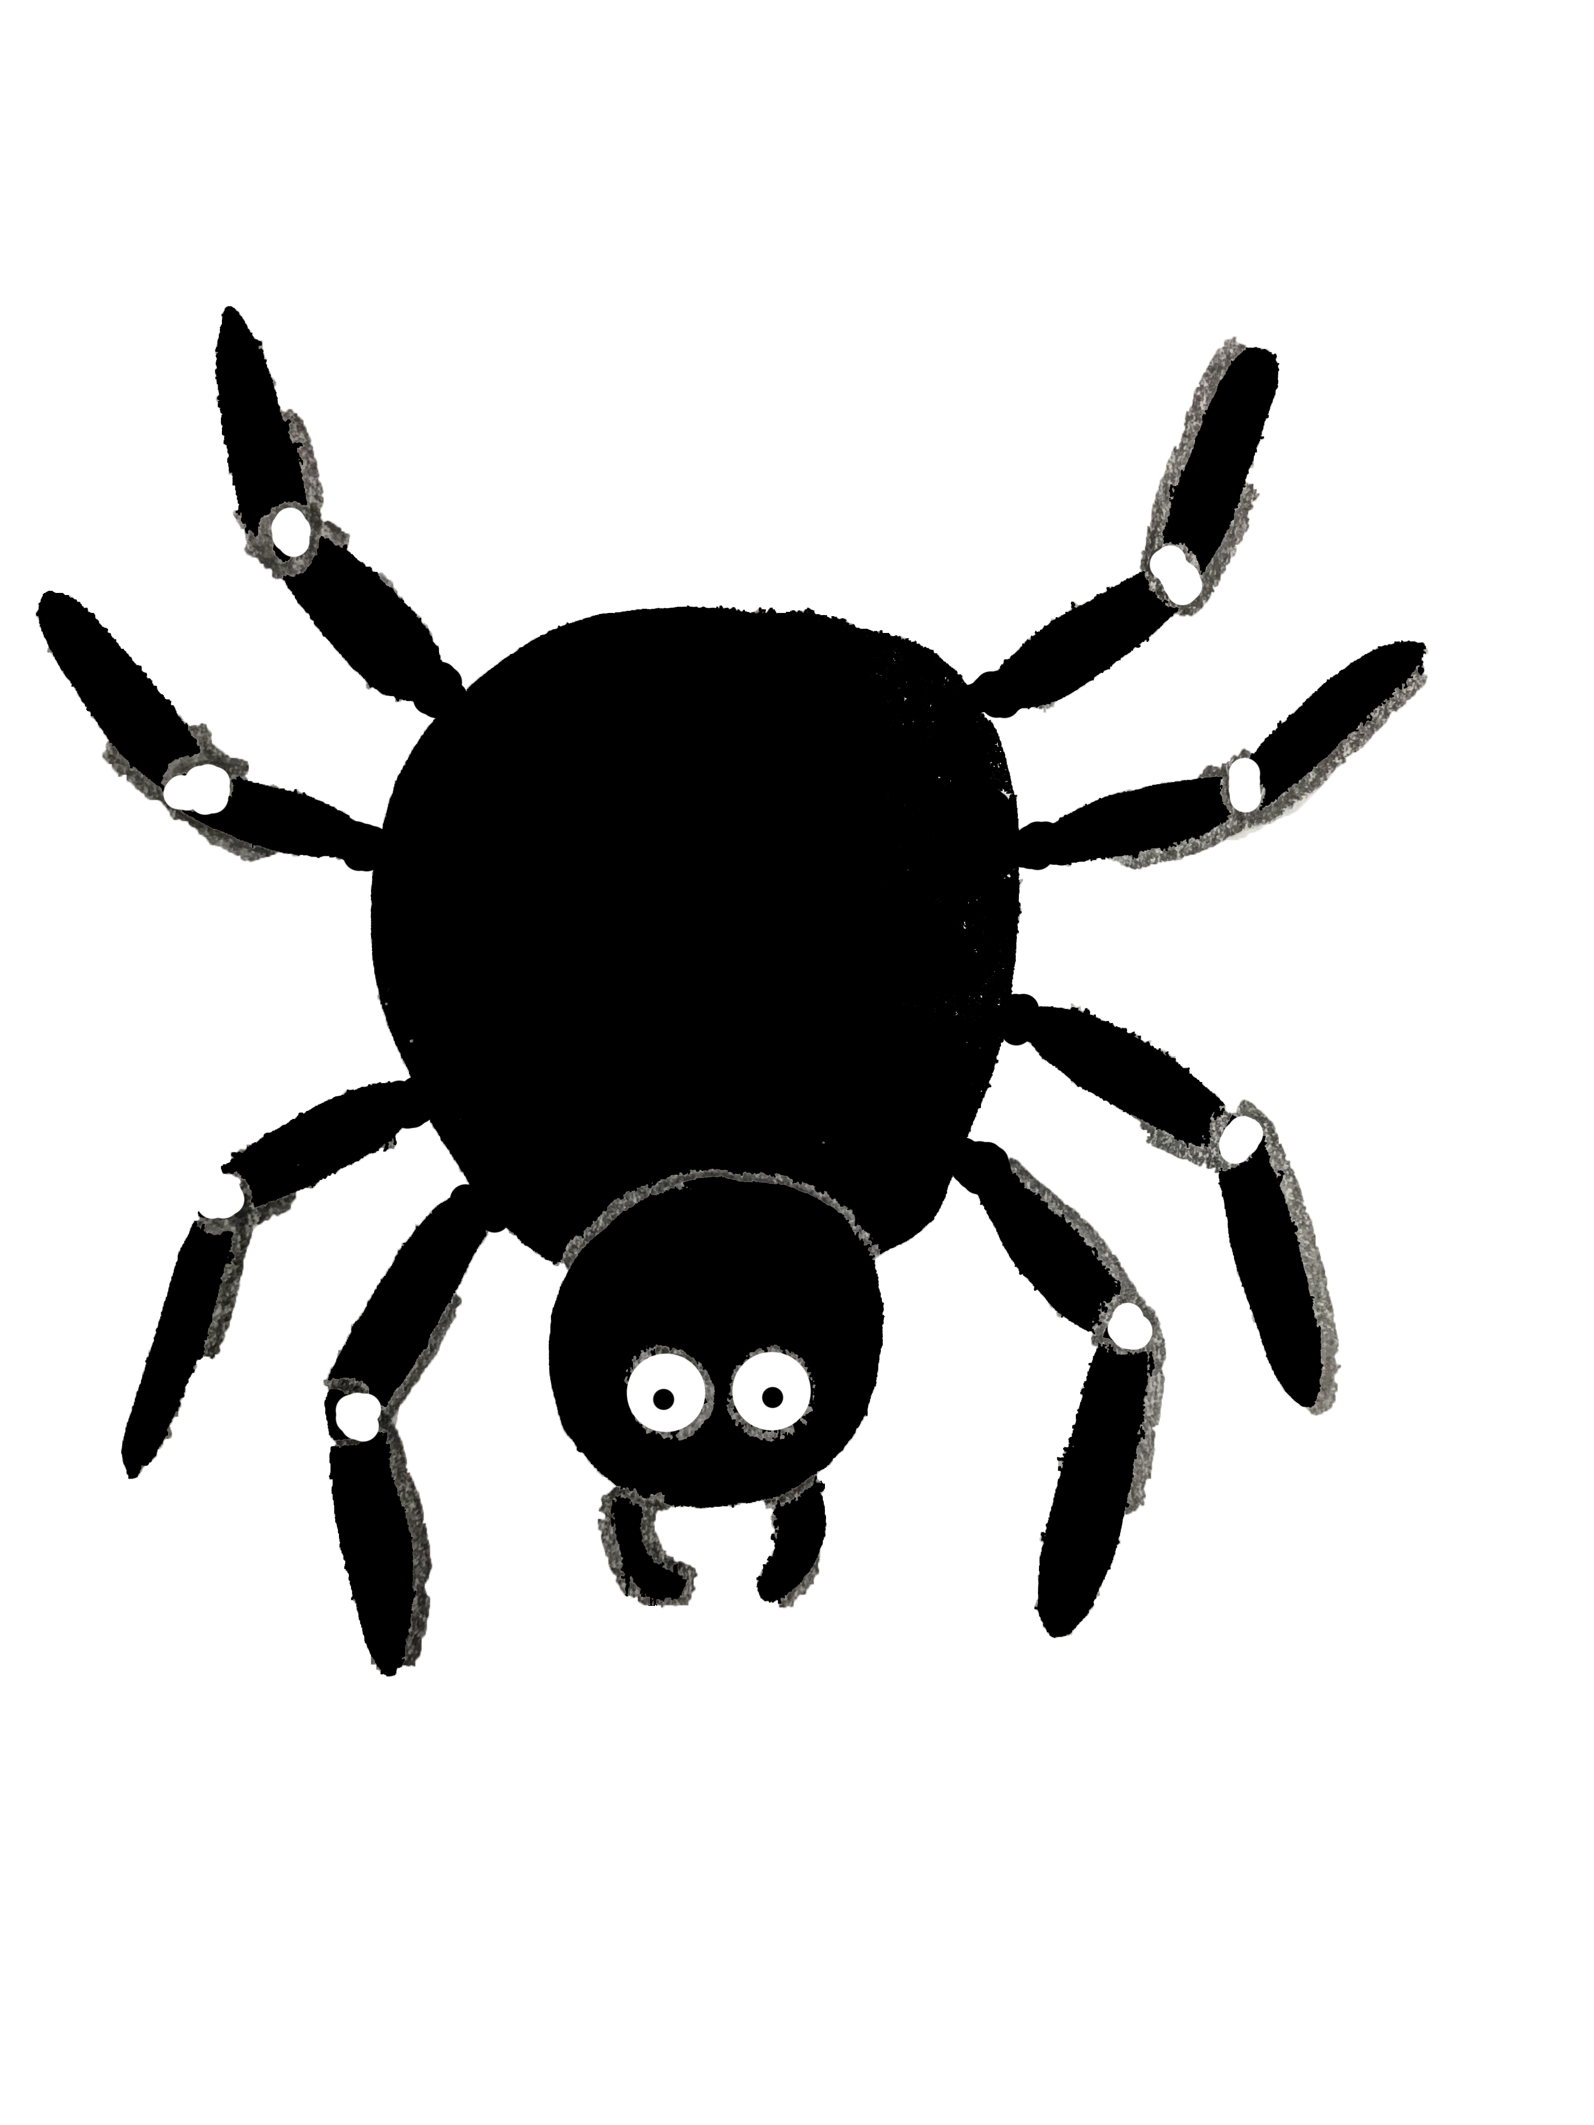
Lines of evolution
Not evolutionarily accurate! (Spider -> Spider monkey)

Slide 6
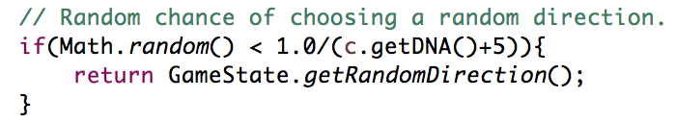
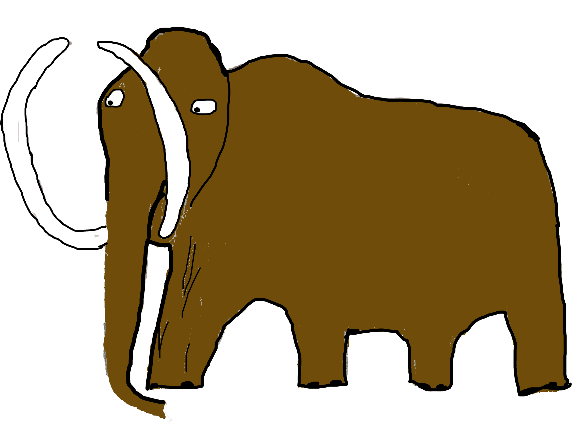
Metrics
How often does a creature become an “Apex Predator”?
Can creatures become too intelligent too quickly?
Randomness factor
BFS vs DFS?

Slide 7
Demo
Disclaimer: We are not graphic designers
Sound on!

Slide 8
Thank you!

